Slide 1
L6 Group 6: Ice-Breaker
Samuel Cook
Anthony Brame
Robert Yearling
William Terry

Slide 2
Logline:
Explore an icebreaker ship as Birch Unravelling a dark secret held deep in the belly of the Snow Slicer.

Slide 3
Demographic
Gender: Males
Age: 18 – 24 (Schell J, 2008)
Type of player: Explorer (Bartle R, 1996)
Why?: The reason males is due to males like to see Spatial puzzles in games and Schell says "Accordingly, puzzles that involve navigating 3D spaces are often quite intriguing to males, while they can sometimes prove frustrating for females." (Schell J, 2008)
Age of 18 – 24 due to having "established certain tastes about the kind of play and entertainment they enjoy." (Schell, 2008)
And "...Explorers are interested in having the game surprise them." (Bartle R, 1996)

Slide 4
Concept:
Theme: Fantasy Steam punk genre
Story: Icebreaker Heading into arctic waters to dispose of an heretical artifact in a deep sea waste site.
Entertainment though Atmosphere (Horror)
Entertainment though Thrills (Suspense)
(Phillips and Huntley, 2004)

Slide 5
Unique Selling Points
Minimal use of non diegetic elements
Voice used to convey objectives (intercom)
Pocket watch system for player navigation and audio recording for in-game lore.

Slide 6



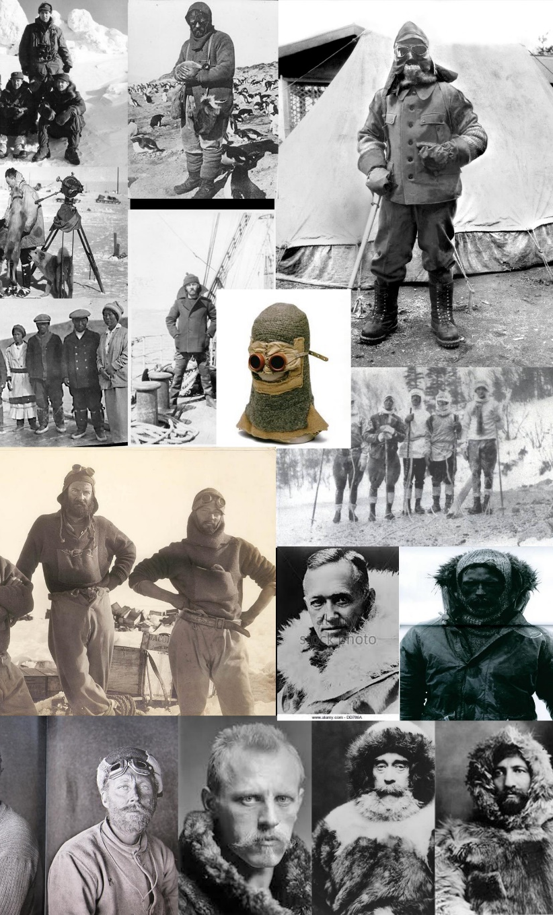



Mood Boards

Slide 7
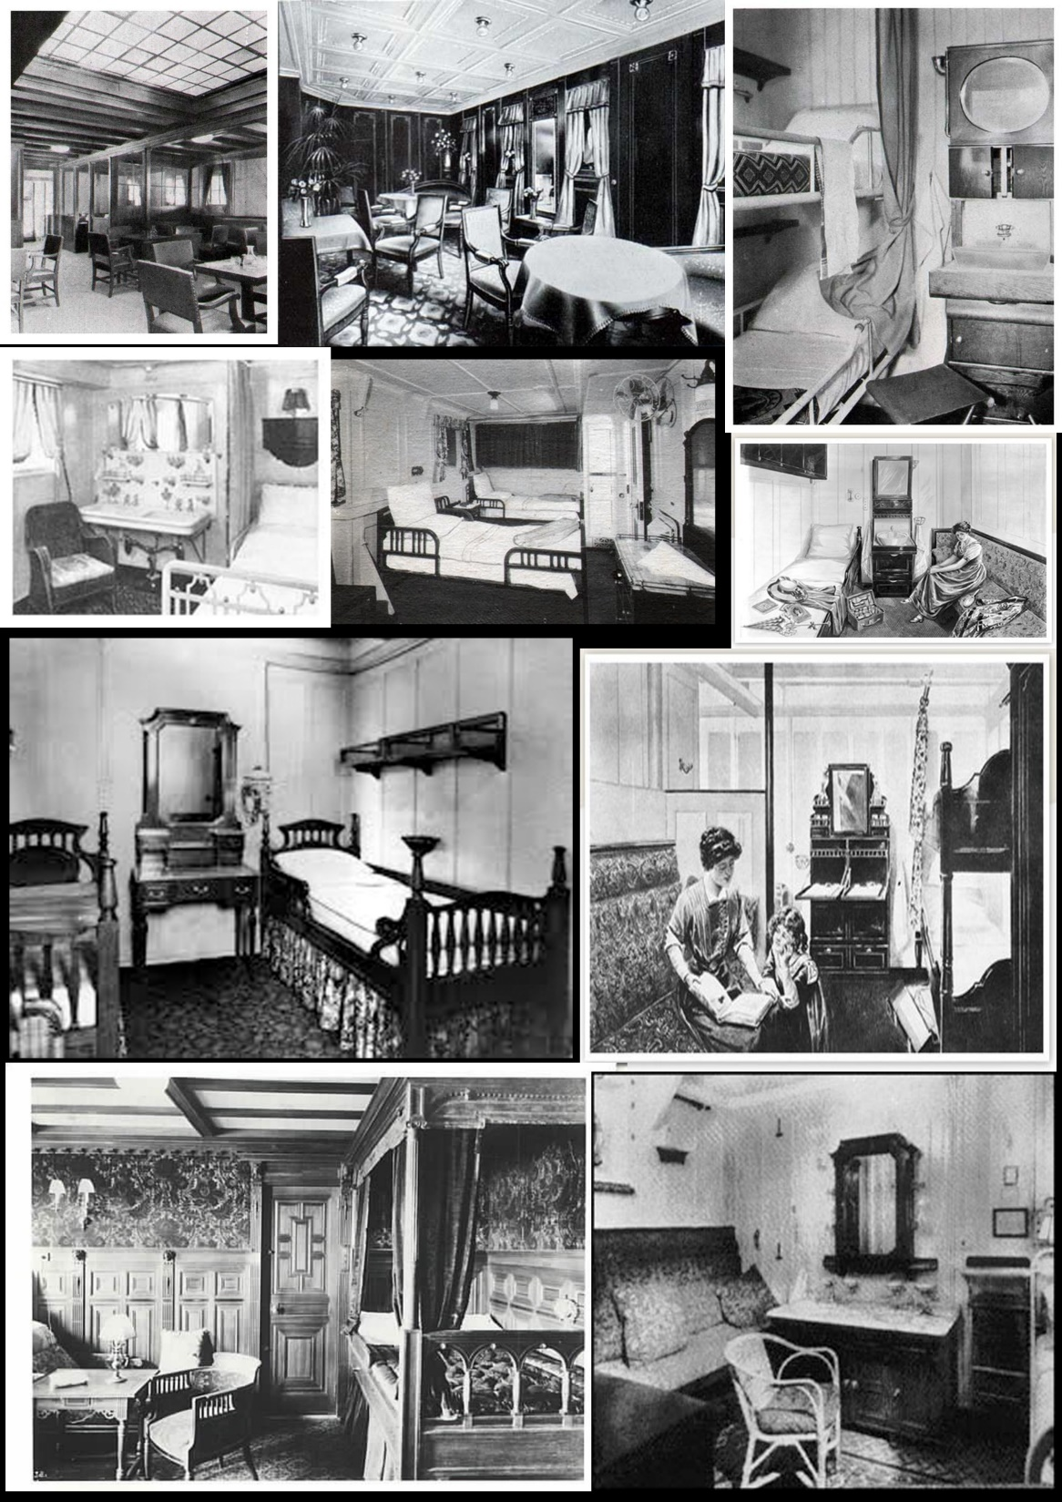
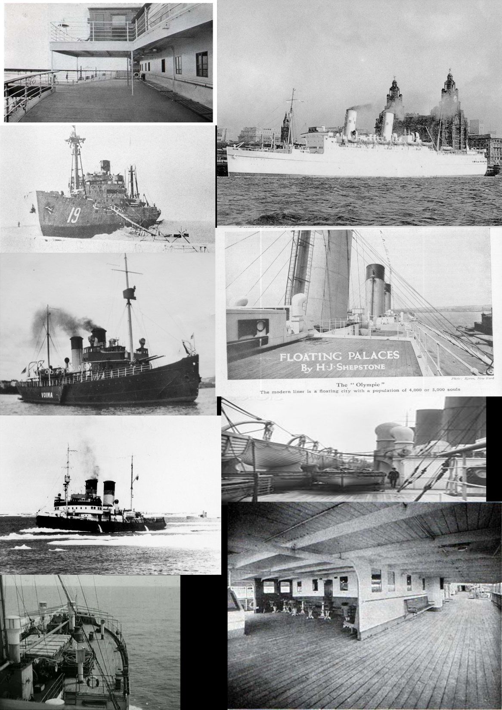

Slide 8
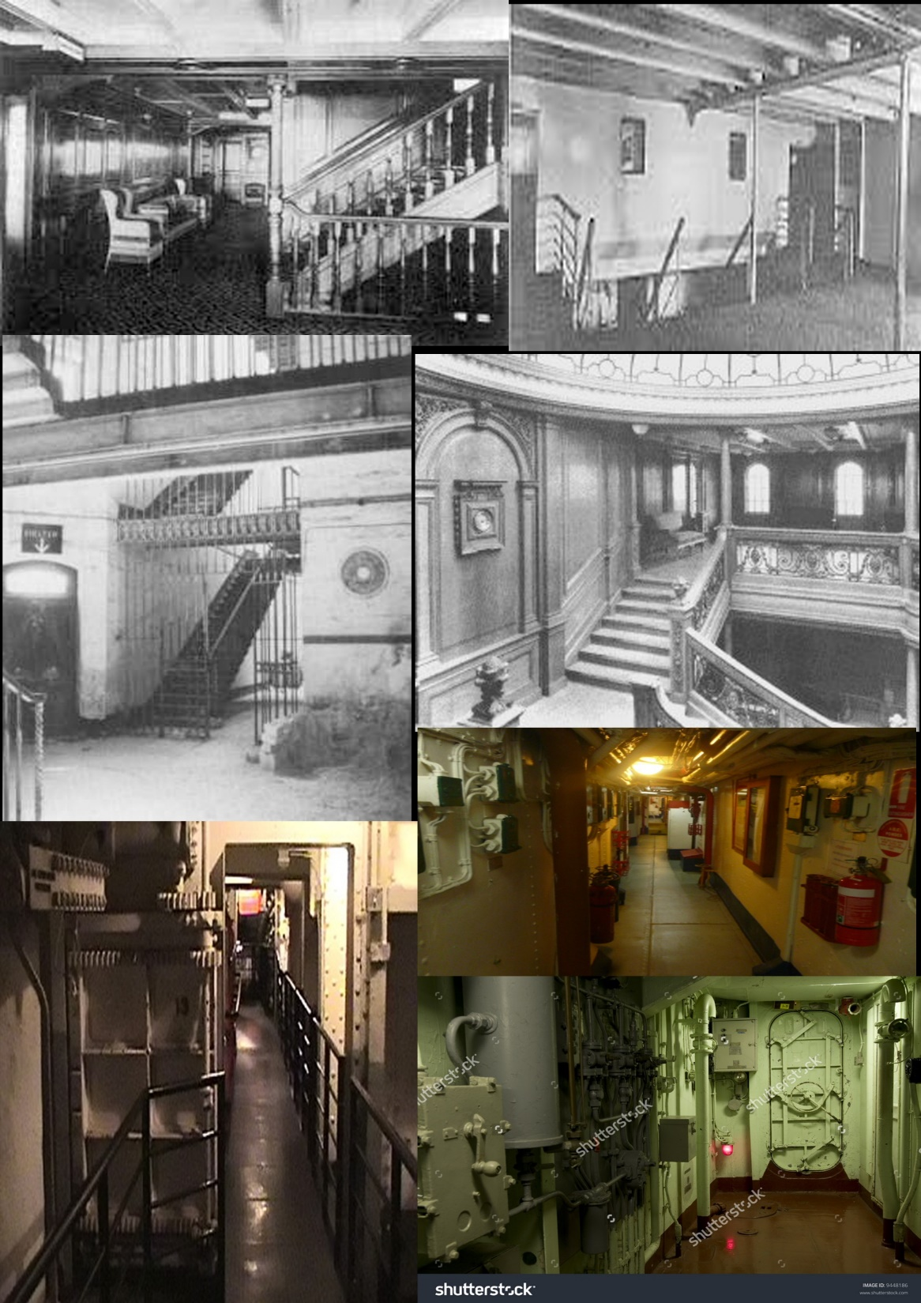
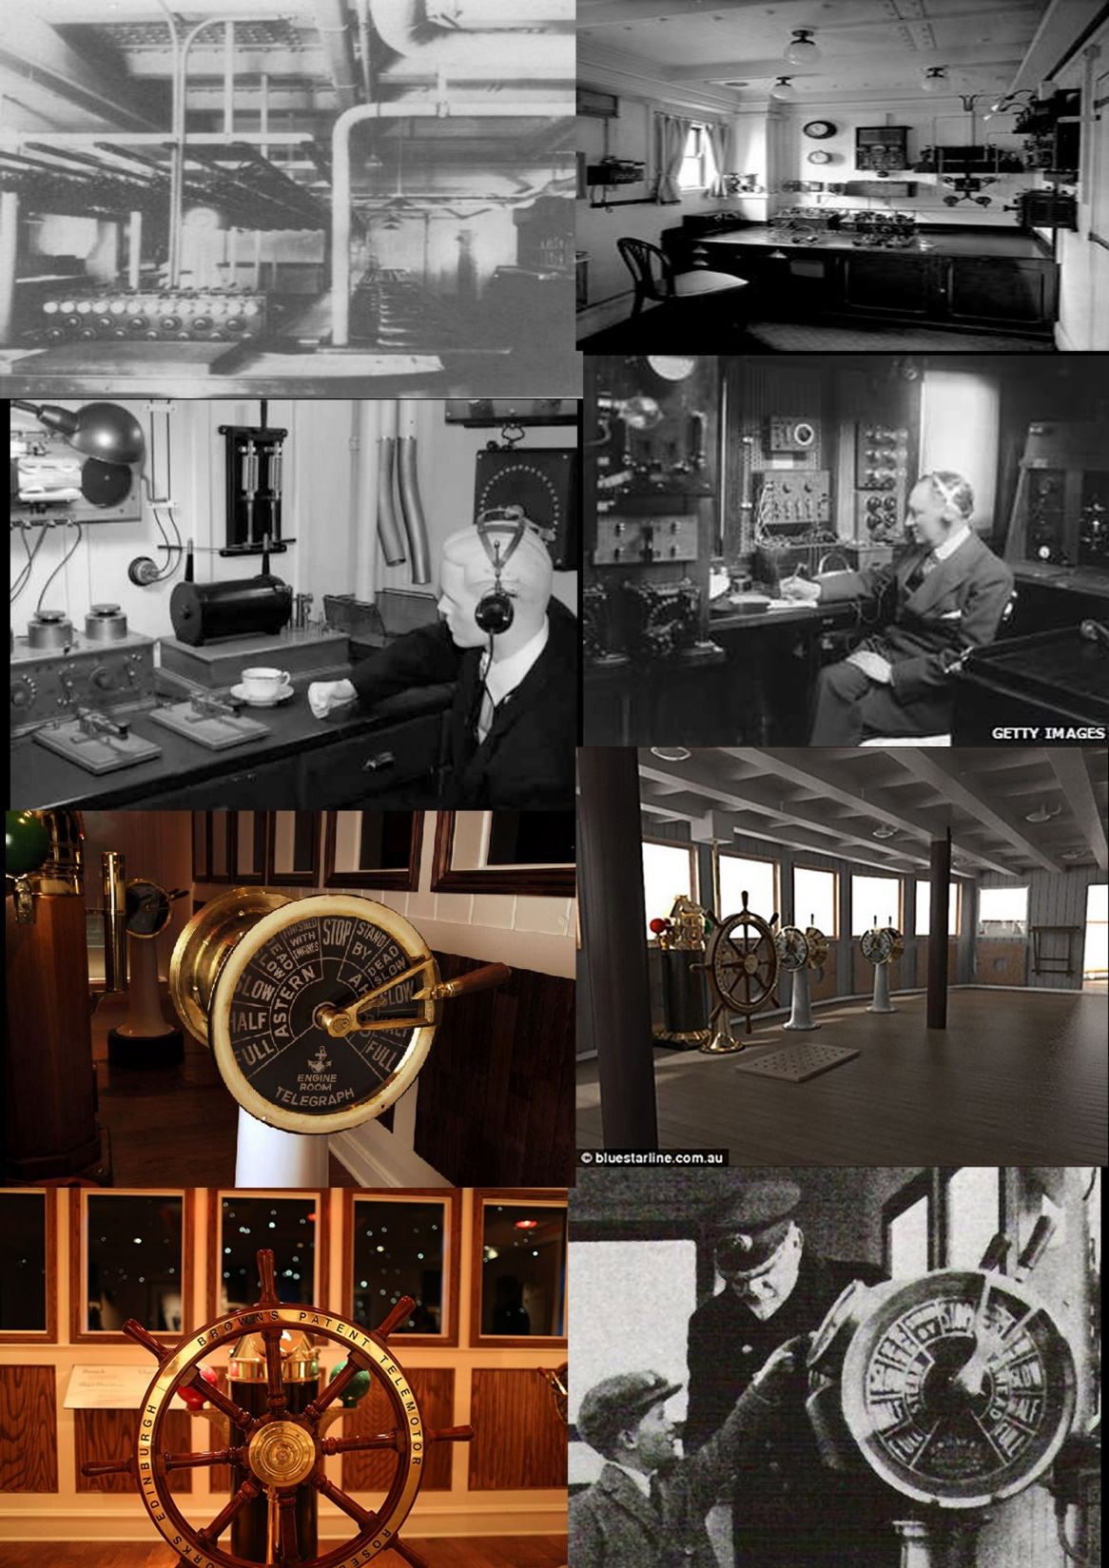

Slide 9
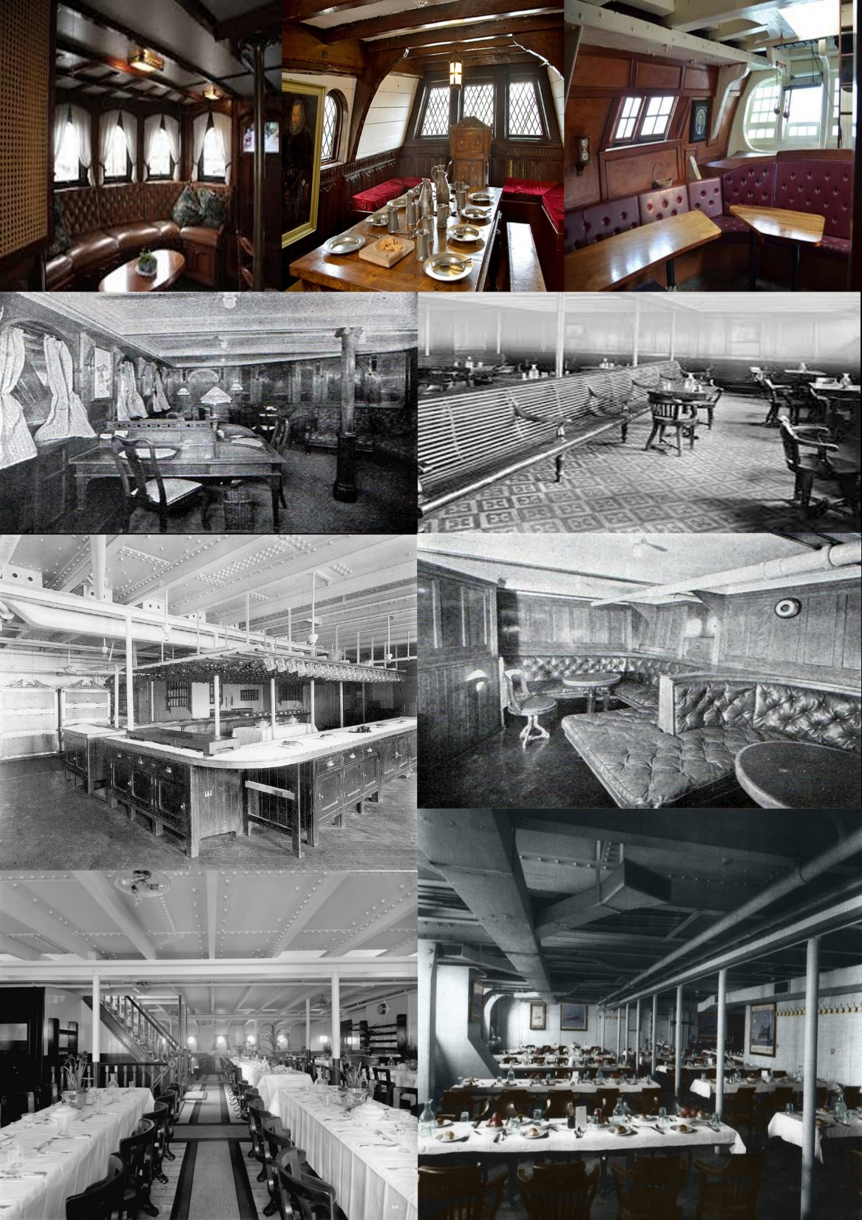
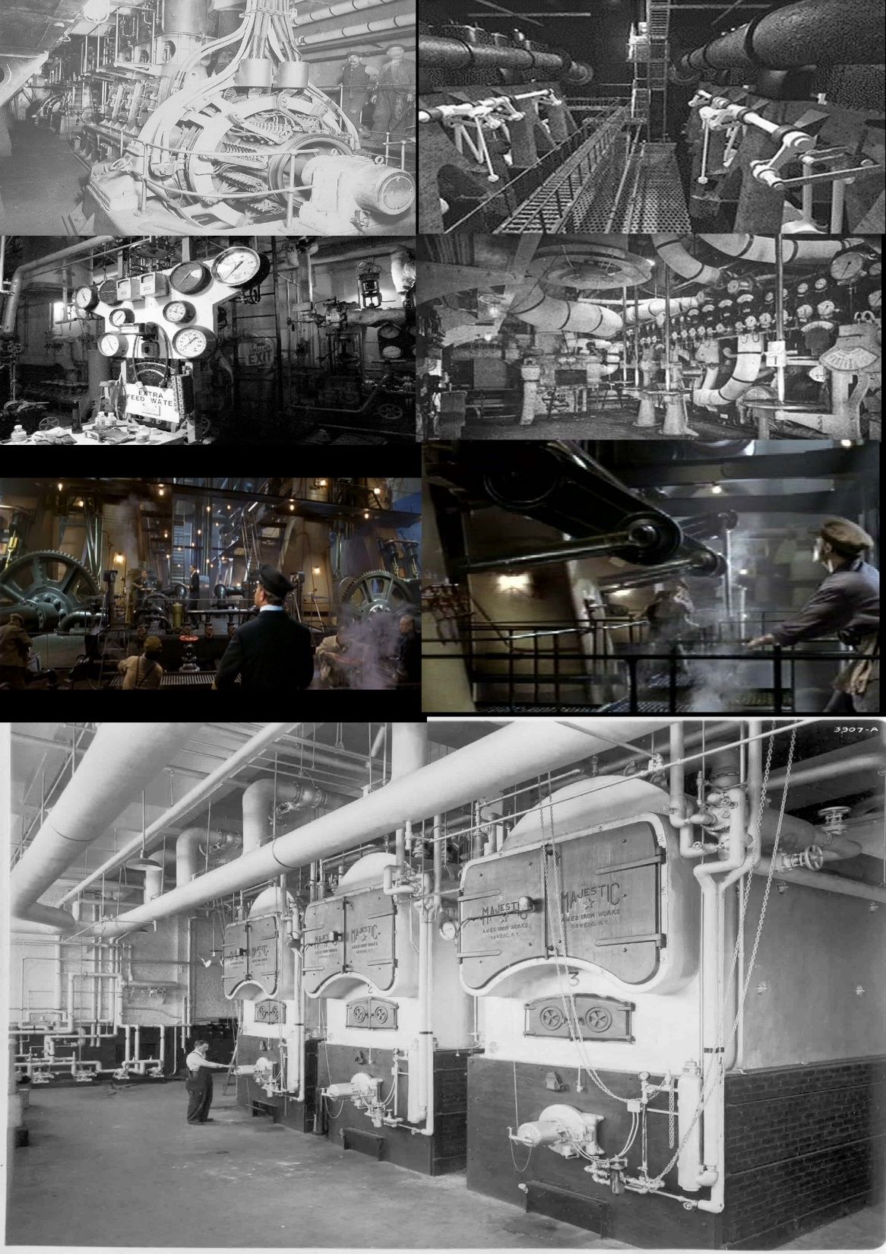

Slide 10
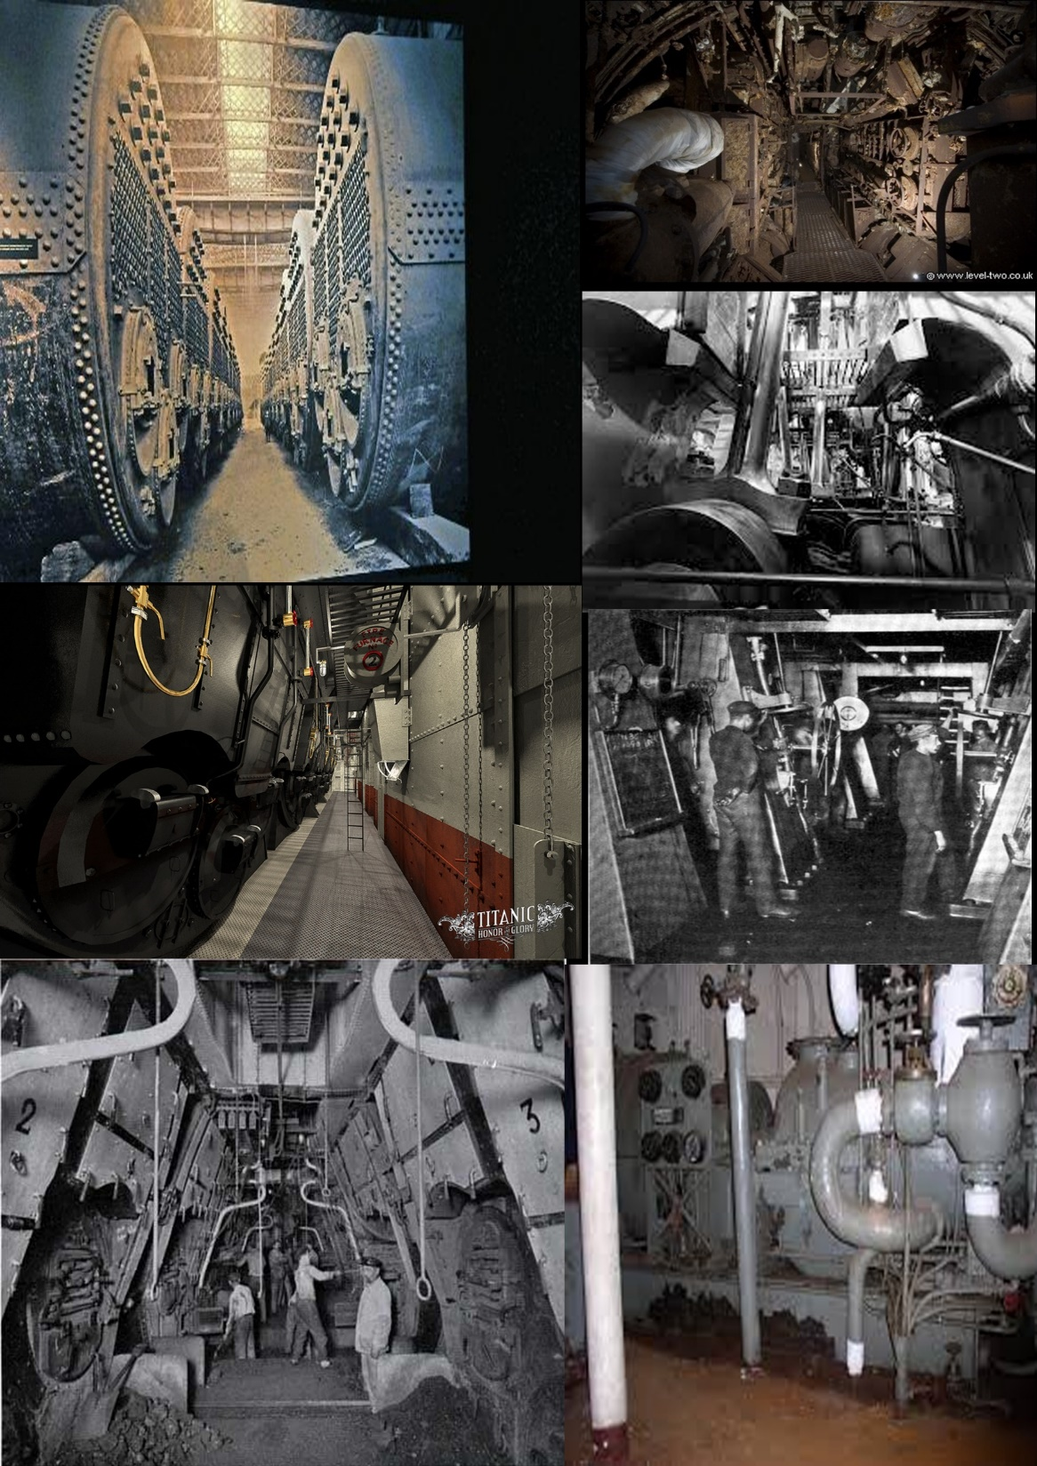

Slide 11
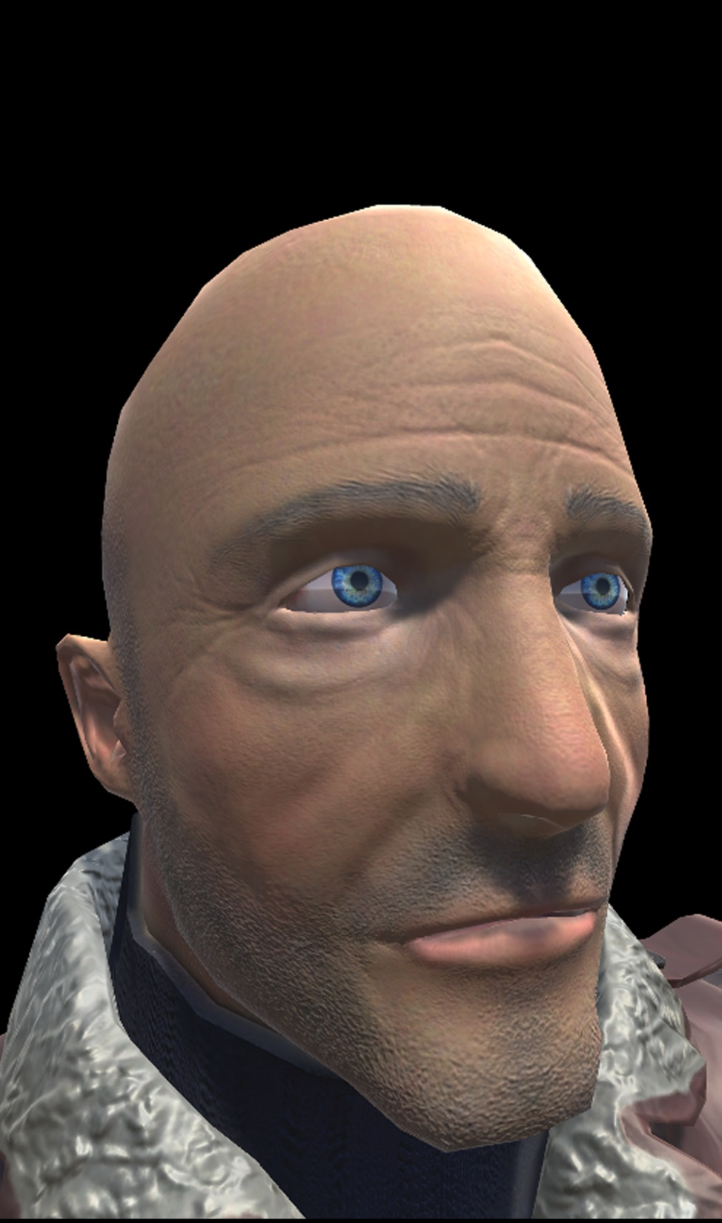
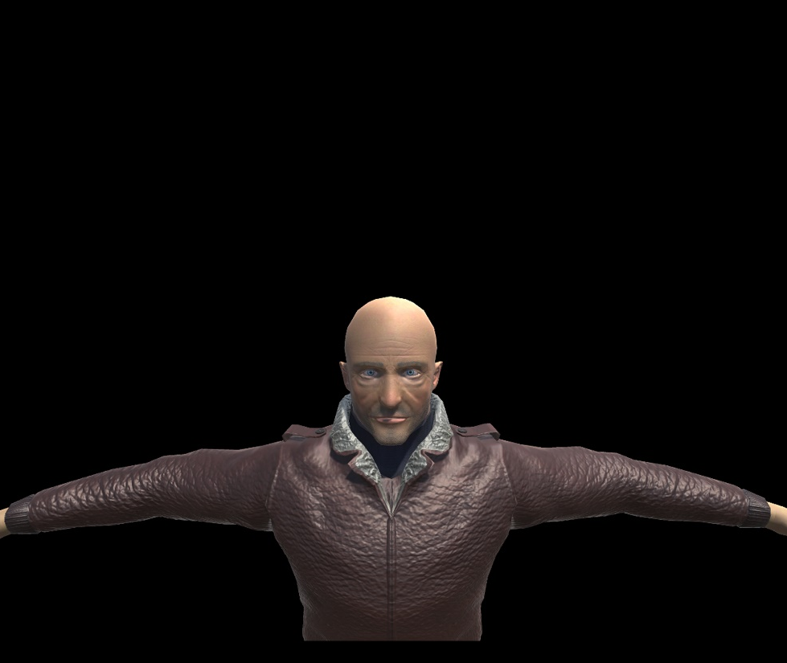
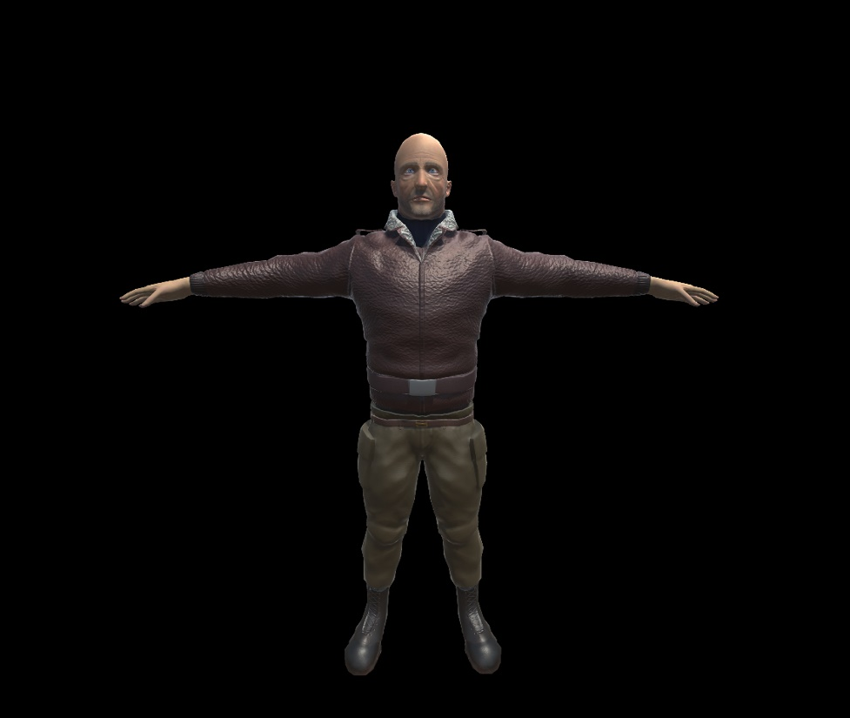
Renders

Slide 12
Mechanics in order of introduction.
Hiding in storage rooms.
Stiff door.
Noise indication for enemy approach.
Scamper view lock.
Sprinter Reduce Movement.
Scamper Tech demo 1:
https://www.youtube.com/watch?v=XCGmRNnAHcM&feature=youtu.be

Slide 13
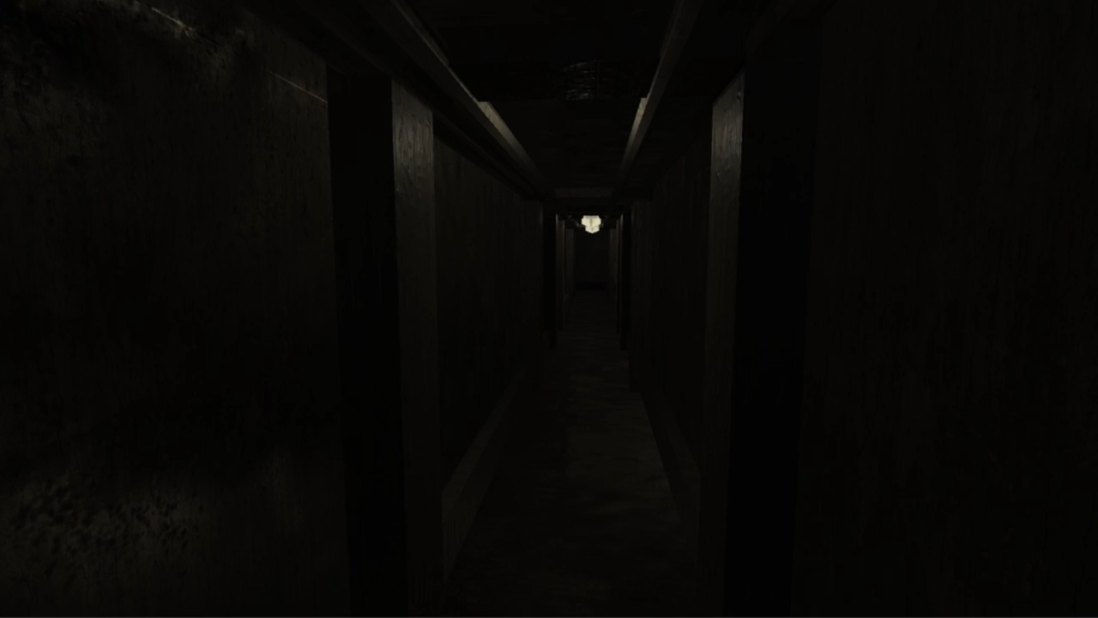
Scamper Tech Demo.

Slide 14
(Addressing the brief)
Type of fun: Easy fun (exploration), Hard fun (LPM)
Narrative focuses: anticipation and foreshadowing
Play sessions: we are hoping to have one to two hours play as a session.
Platforms: PC, Console?
Addressing rewards: New Explorable areas, unraveling narrative, features to watch?
Roles of rhythm and repetition: Spatial puzzles, Repetition though patterns, audio cues.
Failure states to generate meaning and excitement and focus: Moment Enemy over powers the player having instant death, (fiero/ Hard fun)
How are we immersing the player (by sensory, cognitive and/or narrative immersion techniques: We are using a combination of elements, focusing predominately on narrative immersion. Lore can be found though out the game and this benefits the explorer player type, and will increase levels of immersion.
How do we create empathy in game? Why should we care? A question we still need to answer.

Slide 15
Management:
Everyone has been present for all meetings.
A steady stream of work has been produced.

Slide 16
Thank you for listening , Any Questions?
References
Bartle, R. (1996) Richard A. Bartle: Players Who Suit MUDs, Mud.co.uk. Available at: http://mud.co.uk/richard/hcds.htm (Accessed: 17 October 2016).
Phillips, M. and Huntley, C. (2004) Dramatica. Glendale, Calif.: Write Brothers Press.
Schell, J. (2008) The art of game design. Amsterdam: Elsevier/Morgan Kaufmann.

